Slide 1
2026–2030
Strategic Plan
Notes:
Cover A. The eight-county outlines run off the right edge. Pick one of the three covers and delete the other two.

Slide 2
2026–2030
Strategic Plan
Notes:
Cover B. Full-bleed mosaic pattern. Pick one of the three covers and delete the other two.

Slide 3
2026–2030
Strategic Plan
Notes:
Cover C. Corner wedges on cream, following the brand guide corner rules. Pick one of the four covers and delete the rest.

Slide 4


2026–2030
Strategic Plan
Notes:
Cover D. Cream card over the cover artwork, with the heart mark. Pick one of the four covers and delete the rest.

Slide 5
2026–2030
Strategic Plan
Notes:
Cover E. Monogram watermark on a cream card over the cover artwork. Pick one of the five covers and delete the rest.

Slide 6
What's inside
01
Mission and vision
Why the Area Foundation exists, and where it is going.
02
Our values
Excellence, Passion, Integrity, Community.
03
Three strategic pillars
Ignite Impact. Elevate Voice. Build Futures.
04
The plan at a glance
All nine strategies on a single page.
Notes:
Contents. Four numbered sections, rules in Caliche, mosaic entering from the corners.

Slide 7
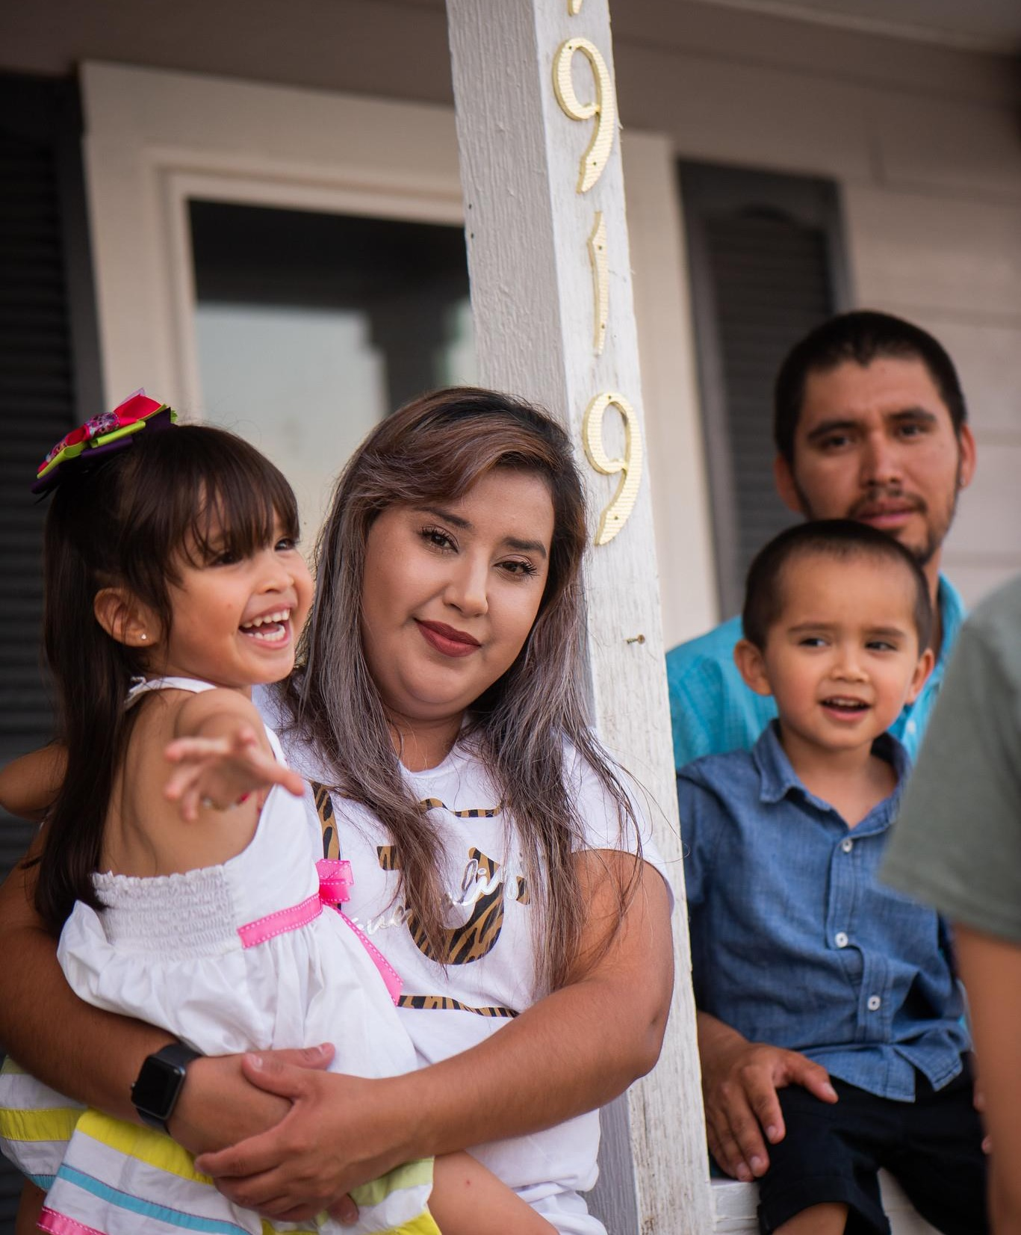
Our Mission
The San Antonio Area Foundation serves as your most trusted and impactful philanthropic partner.
Our Vision
To close opportunity gaps for the people who need it most.
Notes:
Mission and vision, verbatim. Photograph is the client’s own, from the original plan.

Slide 8



Our Mission
The San Antonio Area Foundation serves as your most trusted and impactful philanthropic partner.
Our Vision
To close opportunity gaps for the people who need it most.
Notes:
Mission and vision, alternate treatment: the subject is masked out and set over the brand pattern. Keep this one or the photo-split version, not both.

Slide 9

Our Mission
The San Antonio Area Foundation serves as your most trusted and impactful philanthropic partner.
Our Vision
To close opportunity gaps for the people who need it most.
Notes:
Mission and vision, second alternate: cutout on the cream pattern. Keep one of the three mission slides.

Slide 10
Our Values
E P I C
E
P
I
C
Excellence
Passion
Integrity
Community
We invest in continuous learning and personal development. We exceed expectations in service to others. We do our best. We do it right. We do it now.
We work with humility, energy, and joy. We explore and embrace new ideas. We value and celebrate one another.
We are honest, trustworthy, and transparent. We honor our donors’ wishes. We are accountable for everything we do.
We collaborate to serve and build community. We invest to create positive change. We practice inclusion and diversity.
Notes:
Values on the four core colors. Copy is verbatim.

Slide 11

Three strategic pillars
Ignite Impact
Create a public sense of urgency to solve our region’s most critical issues.
Elevate Voice
We are committed to clarifying who we are — our role, values, and voice — across everything we do.
Build Futures
Inspire both private and public investment for the benefit of our region.
Notes:
The three pillars together. Photograph is the mosaic bench from the original plan.

Slide 12
Three strategic pillars
Ignite Impact
Elevate Voice
Build Futures
Create a public sense of urgency to solve our region’s most critical issues. Forge collective impact on the toughest community needs. Advance innovative and impactful strategies that lead to systemic change and inspire follow-on investment. Close the opportunity gap by supporting and strengthening nonprofit leaders and organizations, and investing in scholars.
We are committed to clarifying who we are — our role, values, and voice — across everything we do. Strengthen brand identity to unify messaging and increase public awareness. Engage communities through inclusive and authentic storytelling. Deepen audience engagement to broaden philanthropic participation.
Inspire both private and public investment for the benefit of our region. Channel the sense of urgency for closing the opportunity gap into new giving. Inspire giving through new legacy commitments and transformational bequests. Secure lasting change through multi-year investments — locally and nationally.
Notes:
Layout library. Three-column text, same style as the two-column layout.

Slide 13
Three strategic pillars
Ignite Impact
Elevate Voice
Create a public sense of urgency to solve our region’s most critical issues. Forge collective impact on the toughest community needs. Advance innovative and impactful strategies that lead to systemic change and inspire follow-on investment. Close the opportunity gap by supporting and strengthening nonprofit leaders and organizations, and investing in scholars.
We are committed to clarifying who we are — our role, values, and voice — across everything we do. Strengthen brand identity to unify messaging and increase public awareness. Engage communities through inclusive and authentic storytelling. Deepen audience engagement to broaden philanthropic participation.
Notes:
Layout library. Two-column text for longer passages.

Slide 14

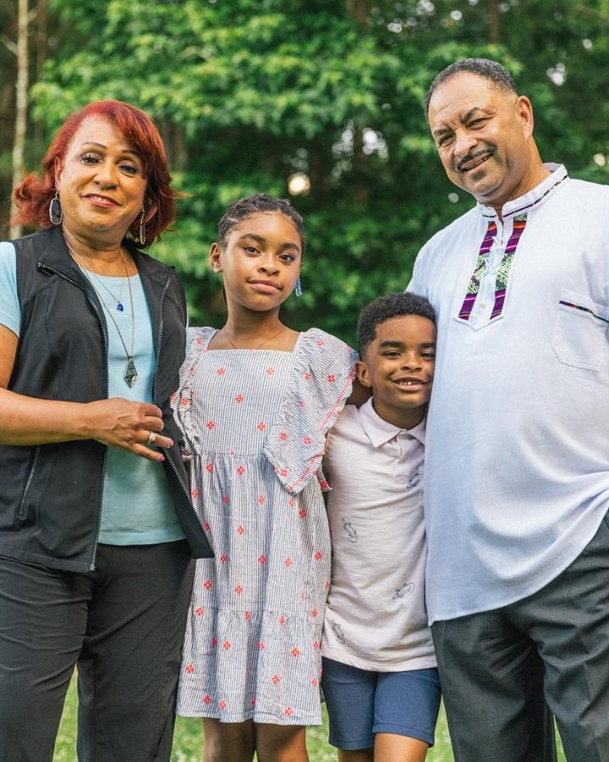

Ignite Impact
PILLAR ONE OF THREE
Create a public sense of urgency to solve our region’s most critical issues.
Notes:
Ignite Impact divider. The client’s own photograph, pre-cropped so it fills half the slide at true proportions.

Slide 15
Our strategies
IGNITE IMPACT
01
02
03
Forge collective impact on the toughest community needs
Advance innovative and impactful strategies that lead to systemic change and inspire follow-on investment
Close the opportunity gap by supporting and strengthening nonprofit leaders and organizations, and investing in scholars
Notes:
Ignite Impact: the three strategies, verbatim from the plan.

Slide 16


Elevate Voice
PILLAR TWO OF THREE
We are committed to clarifying who we are — our role, values, and voice — across everything we do.
Notes:
Elevate Voice divider. The client’s own photograph, pre-cropped so it fills half the slide at true proportions.

Slide 17
Our strategies
ELEVATE VOICE
01
02
03
Strengthen brand identity to unify messaging and increase public awareness
Engage communities through inclusive and authentic storytelling
Deepen audience engagement to broaden philanthropic participation
Notes:
Elevate Voice: the three strategies, verbatim from the plan.

Slide 18

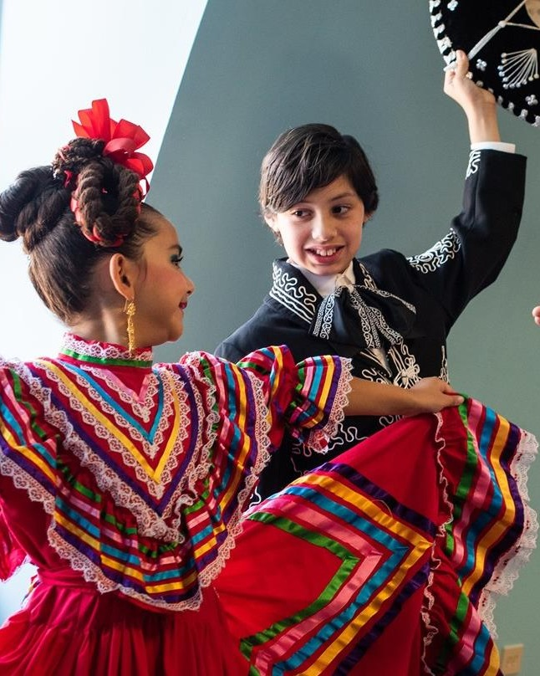
Build Futures
PILLAR THREE OF THREE
Inspire both private and public investment for the benefit of our region.
Notes:
Build Futures divider. The client’s own photograph, pre-cropped so it fills half the slide at true proportions.

Slide 19
Our strategies
BUILD FUTURES
01
02
03
Channel the sense of urgency for closing the opportunity gap into new giving
Inspire giving through new legacy commitments and transformational bequests
Secure lasting change through multi-year investments — locally and nationally
Notes:
Build Futures: the three strategies, verbatim from the plan.

Slide 20
The plan at a glance
NINE STRATEGIES, THREE PILLARS
Ignite Impact
Elevate Voice
Build Futures
01
Forge collective impact on the toughest community needs
01
Strengthen brand identity to unify messaging and increase public awareness
01
Channel the sense of urgency for closing the opportunity gap into new giving
02
Advance innovative and impactful strategies that lead to systemic change and inspire follow-on investment
02
Engage communities through inclusive and authentic storytelling
02
Inspire giving through new legacy commitments and transformational bequests
03
Close the opportunity gap by supporting and strengthening nonprofit leaders and organizations, and investing in scholars
03
Deepen audience engagement to broaden philanthropic participation
03
Secure lasting change through multi-year investments — locally and nationally
Notes:
Summary page. Every strategy in the plan on one slide, grouped by pillar.

Slide 21
List styles
Level one sets the main point. Fiesta Pink bullet, 18 point.
  Level two supports it. River Walk teal dash, 16 point.
    Level three adds detail. Navy mid-dot, 14 point.
      Level four for finer nesting. Fiesta Pink, 13 point.
        Level five is the last defined step. River Walk teal, 13 point.
Press Tab to demote a line and Shift + Tab to promote it. Nothing above is formatted by hand — the bullets, colours, sizes and indents all come from the slide master, so they stay consistent across every deck built on this template.
Notes:
List styles reference. Built on the A1 authoring layout and filled through its placeholders, so it demonstrates the inherited bullet levels rather than hand-set formatting.

Slide 22
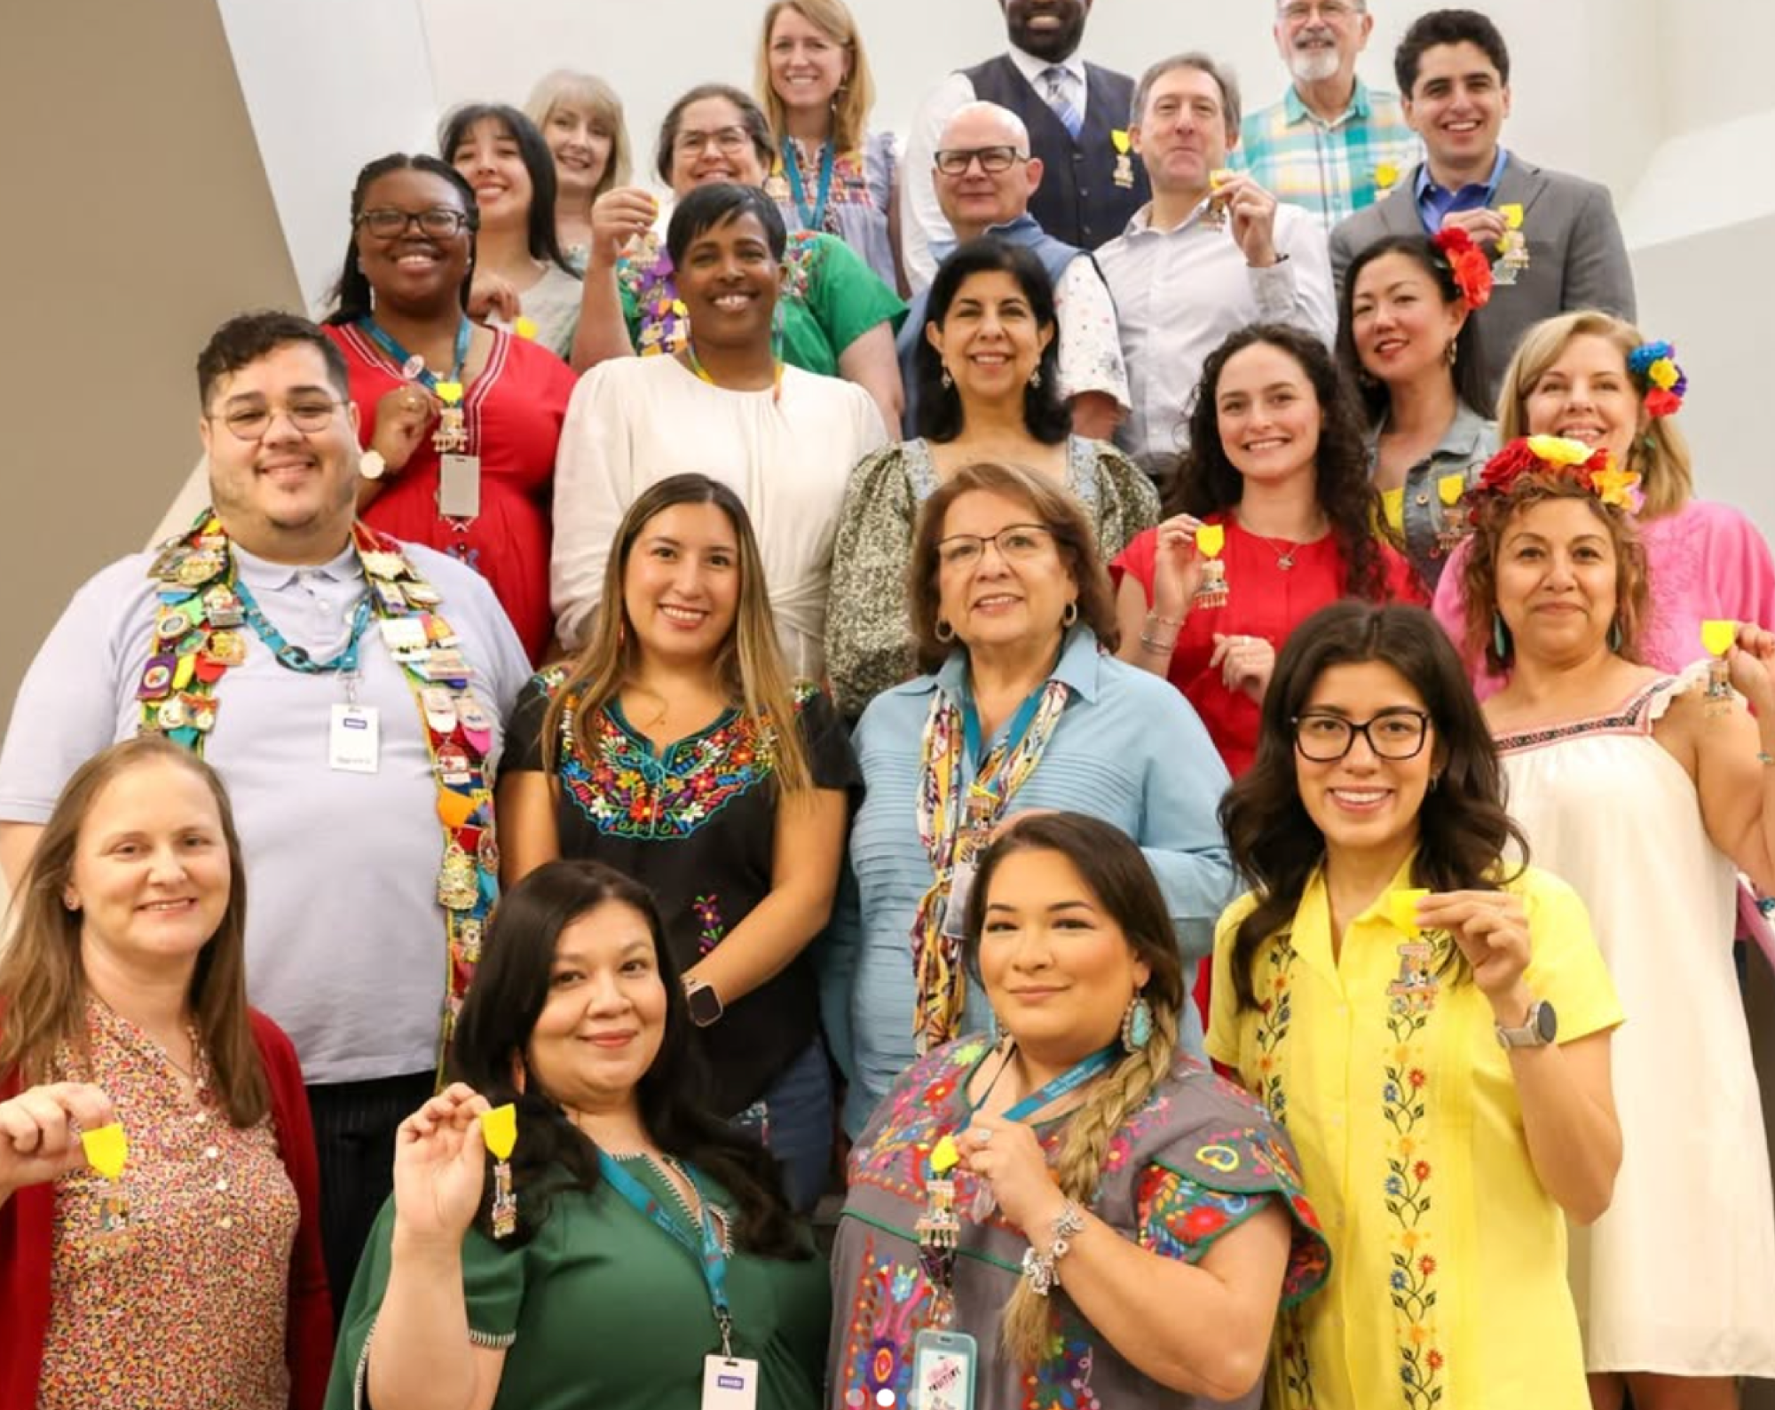
Our
Team
Notes:
Our Team. Group photograph on the brand pattern.

Slide 23

Nadege Souvenir
Nadege Souvenir is a transformative leader committed to strengthening communities, advancing equity, and driving innovation in philanthropy. Since April 2024, she has served as CEO of the San Antonio Area Foundation, stewarding more than 600 charitable funds and $1.3 billion in assets with a legacy of over $800 million in grants and scholarships awarded since 1964 to address opportunity gaps across the region.
Recognized as a 2025 South Texas Power Player by the San Antonio Business Journal, Nadege is helping shape the region’s future through civic engagement and bold philanthropic leadership. She serves on the board of UP Partnership, a collective impact organization ensuring that all young people in Bexar County are ready for the future through data-informed strategies and community collaboration.
San Antonio Area Foundation
CEO
Notes:
CEO bio. Portrait and copy on a cream card over the brand pattern.

Slide 24
We are here to close opportunity gaps for the people who need it most.
Nadege Souvenir
CEO, San Antonio Area Foundation
Notes:
Layout library. Statement slide: one line in the display face on a pattern ground. Replace the copy, or delete the slide if unused.

Slide 25
Your most trusted and impactful philanthropic partner
Notes:
Closing. The promise line from the plan, on Twilight.

